Slide 1
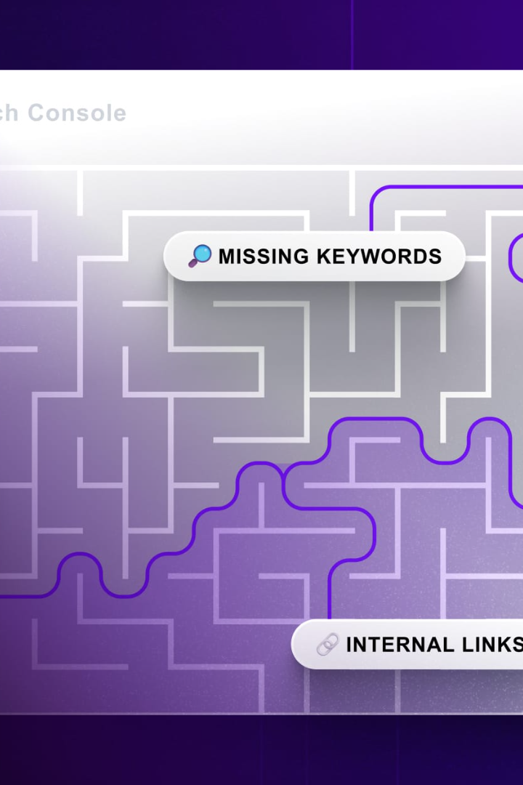
Search Algorithms in AI
An introduction to different types of search algorithms used in AI as well as their real-world applications and case studies

Slide 2
Uninformed Search Algorithms
Depth-First Search (DFS)
Breadth-First Search (BFS)
Depth-Limited Search and Iterative Deepening
Visits the deepest node first. Used in web crawling, maze solving, and game theory.
Explores all the neighboring nodes at the present depth before moving on to the next depth level. Used in shortest path algorithms and maze solving.
A modified version of DFS that limits the depth, which reduces the time complexity. Used in AI game search.

Slide 3


Informed Search Algorithms
Greedy Search
A* (A Star) Algorithm
Exploits the information available at a given point in time to find the node that satisfies the heuristic best. Used in natural language processing and robotics.
Combines the advantages of both BFS and DFS search algorithms. Picks the shortest and most promising path while keeping an optimal balance between heuristic and cost. Used in pathfinding and robot motion planning.

Slide 4
Comparison between Greedy Best-First and A*
A* Algorithm
Advantages: balances heuristic and cost to converge on the shortest and most efficient path. Disadvantages: complex and computationally expensive.
1
2
Greedy Best-First
Advantages: fast and efficiently provides a solution. Disadvantages: may not always find the optimal solution and likely to get stuck in local maxima.

Slide 5
Local Search Algorithms
Hill-Climbing Algorithm
Simulated Annealing
Often used as a sub-routine of other algorithms. Climbs up to the highest point in the immediate surrounding before analyzing the rest of the map. Used in routing problems and image processing.
Combines features of both Exploitation and Exploration. Used in simulated physics and cryptography.

Slide 6
Comparing and Contrasting Different Search Algorithms
Algorithm
Advantages
Disadvantages
Depth-First Search
Simple and efficient
May not find the optimal solution
Breadth-First Search
Guarantees to find the shortest path
Computationally expensive and requires more memory
Greedy Best-First
Fast and efficient
May not find the optimal solution
A* Algorithm
Finds the shortest and most efficient path
Complex and computationally expensive

Slide 7

Real-world Applications and Case Studies
1
Route Optimization
2
Autonomous Vehicles
3
Chess and Gaming
AI can be used to find the shortest and most time-efficient route for package delivery.
Search algorithms are used to plan the route and avoid accidents.
AI uses search algorithms to find the best move or action towards victory.

Slide 8

Conclusion
Search algorithms play a crucial role in AI and its applications. By combining different algorithms or modifying existing ones, developers can improve AI efficiency, accuracy, and performance. With search algorithms, the possibilities are endless!

